Slide 1
SSA Lunch-n-LEARN AGENDA (60 mins)
Introduction (Role, Org, What got you into trying SSA UiPath) – 5 mins
Problem Statement. (Issue, Manual hours) – 5 mins
Workflow of the bot. (Demo, Describing every step, logic, feature, API, Packages used) (10 - 15mins)
Development (15 mins) (AHub)
Conversion Value: Estimated yearly hours saved. You can refer Automation hub details. E.g 100 hours/year
How long did it take for you to build the bot?
How frequently the bot is used?
and what were the pain points?
Transactional volume, (workload, throughput, shows the capacity of the bot,)
Any tips for bot enthusiasts and your SSA UiPath Journey? (5 mins) Q n A. (15 mins)

Slide 2
John’s Case Study 1
Developer: | John Tan
Function: | Operations
Status:
In Production
Problem Statement
Business Driver
SOP reviews are tedious and laborious. Currently, the review process starts with user manually downloading documents from CDOCS. Two documents are downloaded (original version and revision version). The documents are then saved to user specified folders. The download process is repetitive and time consuming
Cost Avoidance and Increase Productivity
Solution Type
Automate
Workflow of the bot
Bot reads input data from Excel file into a DataTable. Bot attaches to browser window
Bot iterates through all data rows. Search documents by SOP reference number. Performs a series of UI interactions (Selectors).
Bot saves each downloaded file to folder. Displays message on successful completion.
Value Realization
 | Projected
Conversion Value | 257 hours/ year
Frequency of Usage | Bi-Monthly
Pain Points
Current As-Is process is highly repetitive, time consuming and potentially error prone (example input of incorrect SOP reference number.). Besides SOP, other documents (FORM) are similarly downloaded
Tips for Future Bot Enthusiasts
Learn the fundamentals.
Add annotations and comments (code readability).
Reusable components
Development Time
8 hours

Slide 3
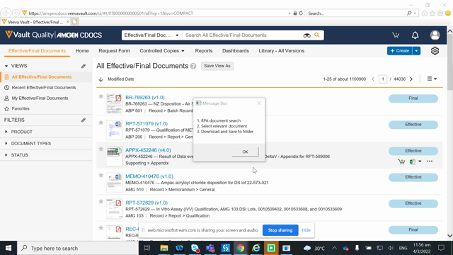
Video – RPA bot execution
Amgen CDOCS document download video
https://web.microsoftstream.com/video/c7f619dd-c8fd-449d-99bf-5bb9c164f259

Slide 4
John’s Case Study 2
Developer: | John Tan
Function: | Operations
Status:
In Production
Problem Statement
Business Driver
ESQ (External Supplier Quality) reviews are repetitive and time consuming. Currently, the review process starts with user manually downloading data from SAP. The downloaded Excel files are saved for further data processing. Data processing includes V-Lookup, filtering and selecting relevant data according to pre-determined business rules.
Cost Avoidance and Increase Productivity
Solution Type
Automate
Workflow of the bot
Bot reads input data from saved Excel file into DataTables.
Bot iterates through all data rows (input data consists of over 5000 rows). Queries with are written in LINQ (Language Integrated Query) to optimize code and enhance execution speed
Bot summarizes processed data for evaluation and review by user.
Value Realization
 | Projected
Conversion Value | 200 hours/ year
Frequency of Usage | Bi-Monthly
Pain Points
Current As-Is process is highly repetitive, time consuming and potentially error prone (example applying incorrect filters to data.)
Tips for Future Bot Enthusiasts
Development Time
Add annotations and comments (code readability).
Reusable components
12 hours

Slide 5
<Bot Use case Name>
Developer:
Function:
Status:
In Production
Problem Statement
Business Driver
Solution Type
Workflow of the bot
Value Realization
 | Projected
Conversion Value
Frequency of Usage
Pain Points
Tips for Future Bot Enthusiasts
Development Time

